Slide 1

Lexington County Mission and Vision Statements Mission Provide quality services to our citizens at a reasonable cost. Vision Planned growth for our communities with abundant opportunities for all in a quality environment.

Slide 2
Public Works Objectives 1 – Reduce County dirt road maintained mileage by 8 miles each year for the next 5 years. (Average reduction over last three years = 5.5 miles) 2 – Rebuild / Rehabilitate 20 miles of the County Maintained Dirt Roads each year over the next 5 years. (Average for last three years = 10.3 miles)

Slide 3
Lexington County Road Maintenance (By Responsibility)
Entity | Paved |  | Dirt |  | Total
SCDOT | 1,483 | 66.8% | 28 | 3.5% | 1,511 | 50.1%
County | 584 | 26.3% | 648 | 81.6% | 1,232 | 40.9%
Municipal | 35 | 1.6% | 3 | 0.4% | 38 | 1.3%
Private | 117 | 5.3% | 115 | 14.5% | 232 | 7.7%
TOTALS | 2,219 |  | 794 |  | 3,013 | 100.0%
 |  |  |  |  | LR | 9/15/16
Lexington Co. Paved Road System is growing by 11 miles/yr

Slide 4
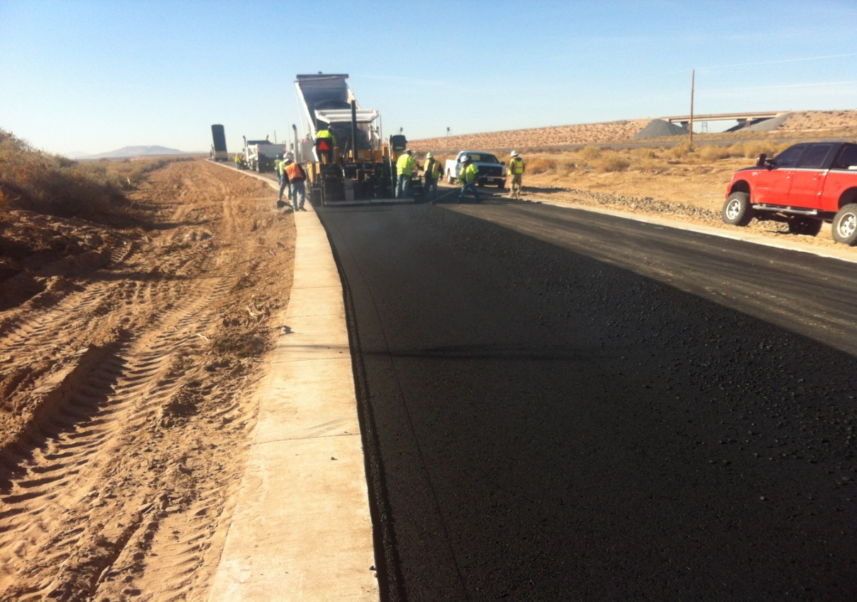
SC State Gas Tax Funds the C-Fund Account
In SC, the Gas Tax is 35.15 cents per gal:
Of which; the State Tax is 16.75 cents, and the Federal Tax is 18.4 cents.
DOT allocates 2.66 cents/gallon of State tax to the 46 Counties’ C-Fund Accounts = about $69 M / Yr.
$69 M is divided among 46 counties based on each county’s land area, population, and rural road miles as a ratio to the state’s totals of these three factors.

Slide 5
Lexington County’s C Fund Allocation
Based on the distribution formula for the 2.66 cent per gallon state gas tax, Lexington County receives approximately the following amount of C-Funds each year:
SCDOT Annual Apportionment $2.85M
Donor County Settlement $1.3 M
Investment Interest $ 40 K
Total Revenues $4.2 M

Slide 6
C-Fund Donor County Facts
There are 16 Donor Counties, and 30 Recipient Counties in South Carolina.
The 16 Donor Counties “donated” $16M to the 30 Recipient Counties.
The $16M represents 23% of the total $69M gas tax allocations.
The top five total gas receipts counties are:
Greenville, Charleston, Lexington, Horry, and York

Slide 7
Lexington County C-Fund Donor Facts
Lexington County is the Second highest contributor to the Donor County portion of the C-Funds.
Lexington County “donates” about $2.3M to the other 30 counties; this represents 14.5% of the total $16M “donations to others.”
Lexington County receives about $1.3M in Donor Bonus from the $9,500,000 Donor Settlement Account as compensation for our “donation” of $2.3M; thus leaving a net loss of about $1M in gas tax contributions.

Slide 8
Lexington County’s C-Fund Donor Status Calculation
Total Receipts $ 5.1M A
Gas Tax Allocation $ 2.8M B
(Based on 1/3 formula for Land Area, Population, Rural Miles)
Contributions in Excess $ 2.3M C=A-B
(Donation to other Counties)
Donor Bonus Settlement $ 1.3M D
(14.5% of $9.5 M C-Fund Donor Bonus)
Interest (estimate) $ 40K E
Total C Fund Allocation $ 4.2M F=B+D+E
Net Donation to other Counties= $ 1.0M G=C-D

Slide 9
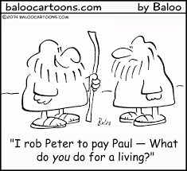
Status of Public Works Programs

Slide 10
Public Works Service Requests FY 13-14 thru FY 15-16

Slide 11
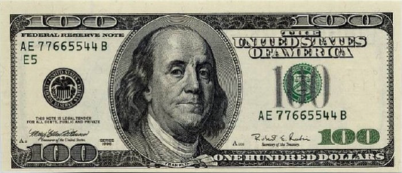

Dirt Road Paving Funding Deficiencies
Current Need Current Funding
Cost of paving dirt roads varies depending on topography, drainage, easements, base conditions
Typical Construction Costs = $500,000 to $800,000 /mile
County currently maintains 648 miles of dirt roads
Current funding for Dirt Road Paving = $2.8M / Yr
$2.8M divided by 648 miles = $4,321 / mile
Result : 200 years to pave all dirt roads in Lexington County

Slide 12
Resurfacing Funding Deficiencies
Current Need Current Funding
Cost of Resurfacing of roads depends on amount of repairs needed to road Before resurfacing
Contract Costs range from $100,000 to $200,000 / mile
Current County funding for Resurfacing = $800,000 / Yr
$800K / 584 miles paved road = $1,370 / mile
Result is Resurfacing Cycle is 60 year plus instead of standard 20 year cycle

Slide 13
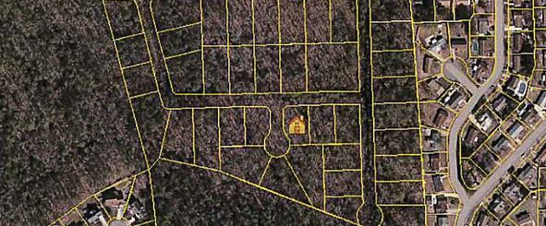
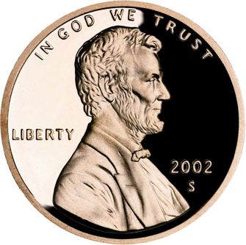
Drainage Improvements Funding Deficiencies
Current funding = $500,000 ($250K C-Funds & $250K General)
700 Sq. Miles of Land Area = 448,000 Acres
$500,000 divided by 448,000 Acres = about $1.00/Acre
Typical Drainage Projects cost $10,000 to $200,000
Ratio of Typical Project Cost to Funding per Acre

Slide 14
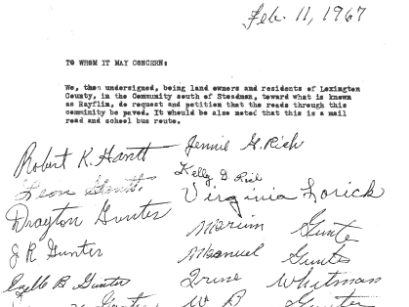
County currently has 335 pending dirt road paving Petitions, totaling 230 Miles, $150 Million in Costs
Some dirt road paving Petitions
are almost 50 years old

Slide 15

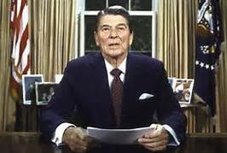
There is a tremendous backlog of Petitioned roads
151 of the 335 (45%) pending road paving Petitions were signed in the 1980’s or earlier
Current C-Funds allows Public Works to pave about 3 miles per year; thus it will take over 75 years to pave all the roads on the C-Fund Petition Paving List.

Slide 16
Lexington County’s C-Fund Program
NOTE: Only $1.9M is used toward paving dirt roads
Notes:
C Funds are currently the only source of funds the County uses to pave dirt roads. Out of the $4.2M we receive in C Funds, only about $1.9M is used toward paving dirt roads.

Slide 17
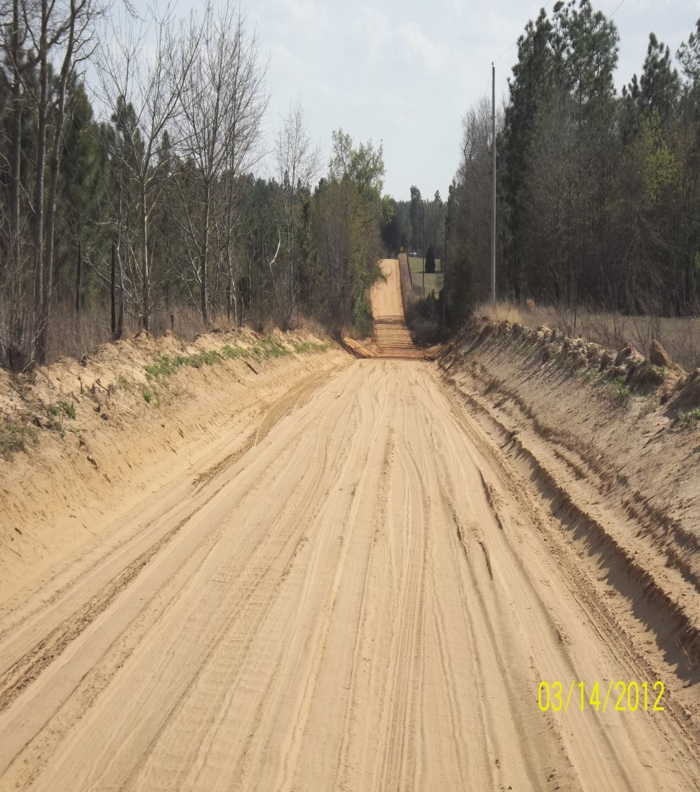
Our dirt roads have been scraped so many times they have become more like drainage features instead of roads
Council has approved additional funding and equipment toward solving this continuous maintenance issue
Notes:
Most roads have been scraped so many times that the cross-sections are now “drainage features” because the adjacent land is several feet higher than the center line profile elevation of the roadway.
Restore road elevation and grading using suitable borrow material
Install base material
Install/upgrade stormwater conveyance system
Obtain multiple drainage easements to reduce impacts on individual properties

Slide 18
In-House Paving Program
Goal is to pave a dozen roads and three miles per year
Projects selected based on efficiency improvement, maintenance costs, environmental and safety issues, “shovel ready” (ie little or no PE or R/W needed)
Efficiency Improvements – mobilizing motorograders up to 10 miles to scrape isolated dirt roads is not efficient use of extremely limited resources
Maintenance Costs - Scraping dirt roads is a classic “Definition of Insanity”
Environmental & Safety – Erosion causes sediment issues in streams and ponds and on paved road surfaces
Shovel Ready – Small scale projects, less than ½ mile, little or no engineering or right-of-way needed

Slide 19
Summary of 2015 Storm Damages
152 County Roads Were Closed (127 Dirt, 25 Paved)
148 County Roads Re-Opened (124 Dirt, 24 Paved)
4 County Roads Still Closed (3 Dirt, 1 Paved)
A total of 244 County and State roads closed during Storm, 13 of these roads are still closed
Estimated Damages / Repair Costs for County Roads and Drainage Systems = $6 Million
219 Floodplain Permits have been issued
351 Flooded Structures assessed at < 50% Damaged
24 Flooded Structures assessed at > 50% Damaged

Slide 20
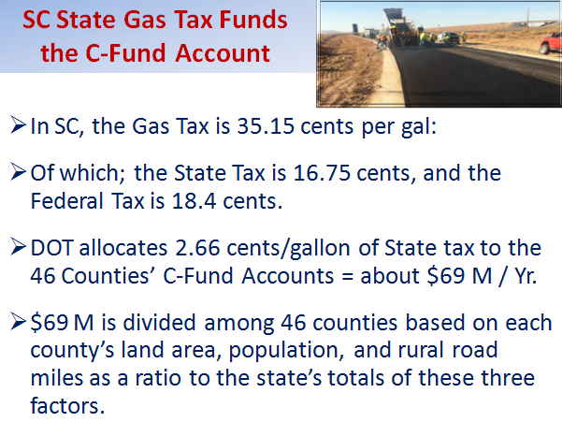
So We End Right Where We Began

Slide 21
S-48 (Columbia Avenue) Corridor Improvement Project
Purpose and Need:
To reduce traffic congestion within the Columbia Avenue Corridor between I-26 and US 76
Lexington County Chapin, South Carolina
Segment of S-48 (Columbia Avenue) No-Build Scenario | 2013 ADT* | Projected 2040 ADT* | Increase from 2013 | 2040 Level of Service
S-49 (Peak Street) to I-26 | 12,500 | 16,700 | 33.6% | F (gridlock)
S-51 (Amicks Ferry Road) to S-49 (Peak Street) | 8,900 | 11,900 | 33.7% | D (congested)

Slide 22
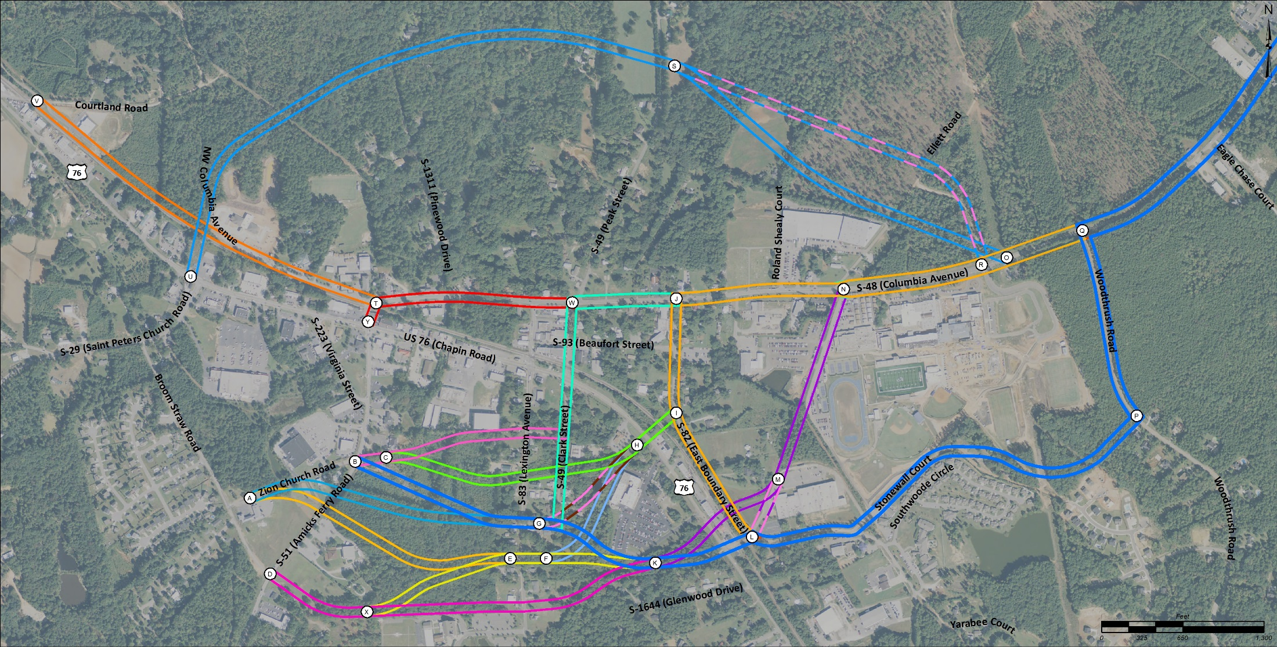
Alternatives Considered Presented at 1st Public Information Meeting (November 2014)
Approximately 20 comments were received
A total of 31 Alternatives were evaluated

Slide 23
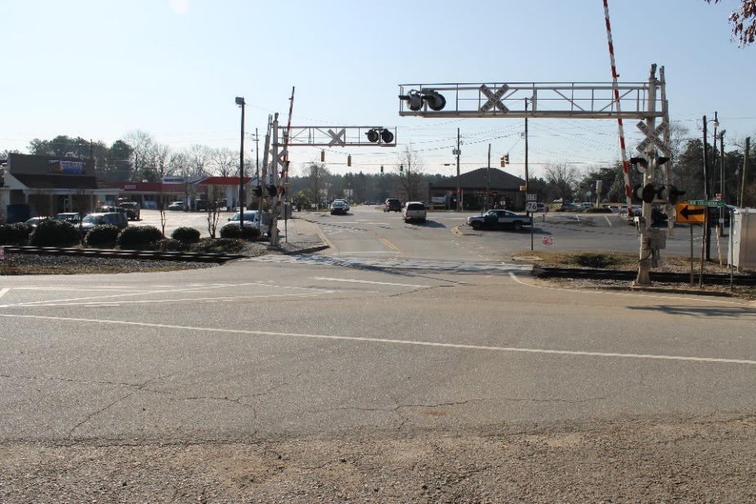
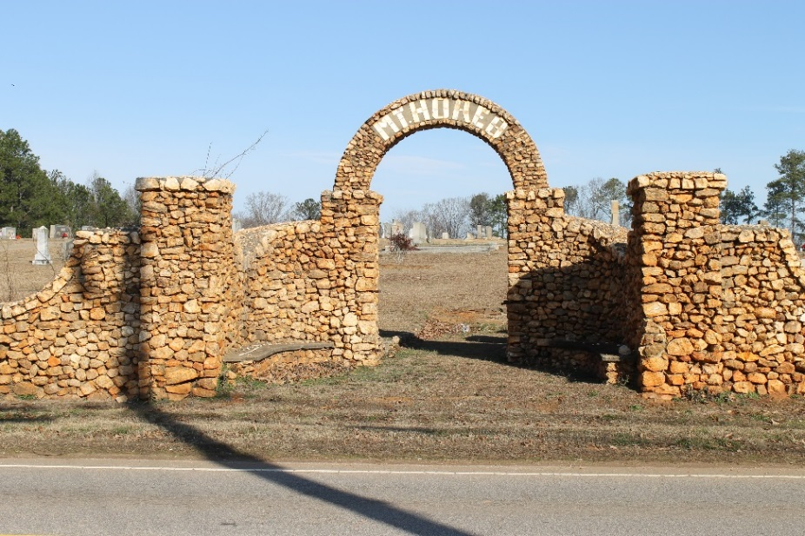
Key Evaluation Factors
Residential Relocations
Commercial Relocations
Local Church Impacts
Natural Resources
Roadway Safety
Railroad Crossing Safety

Slide 24
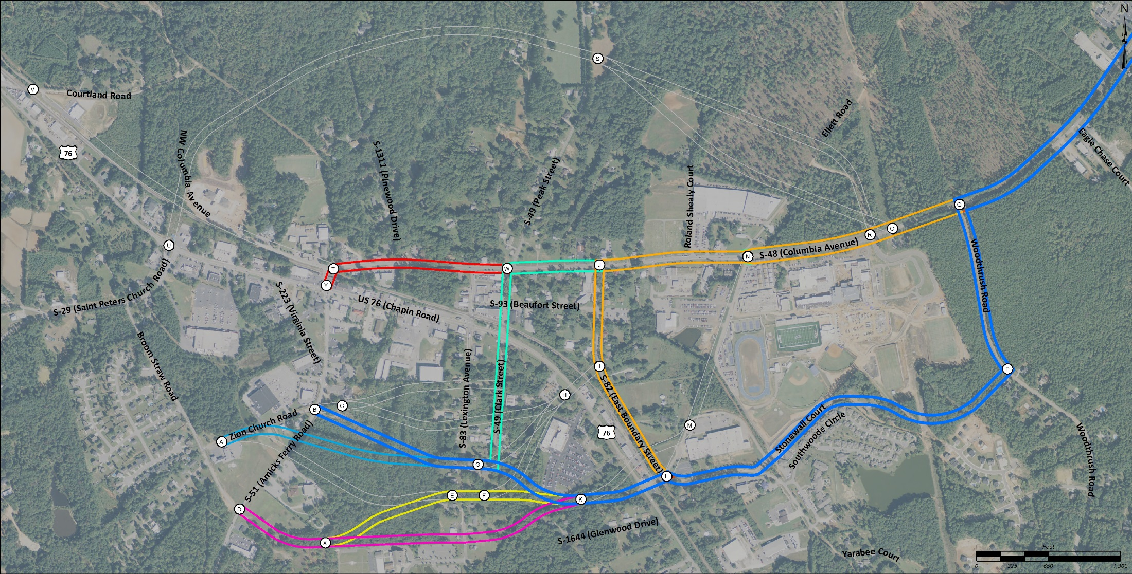
Alternatives Considered for Further Analysis
10 total Alternatives
10 Alternatives

Slide 25
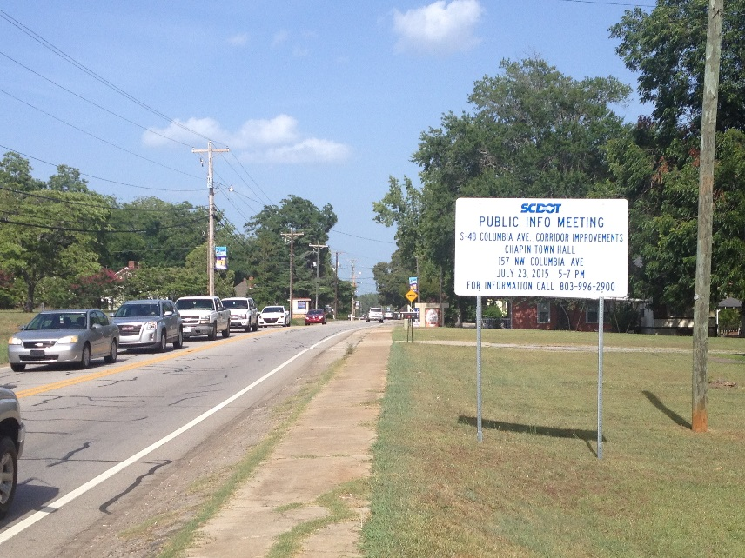
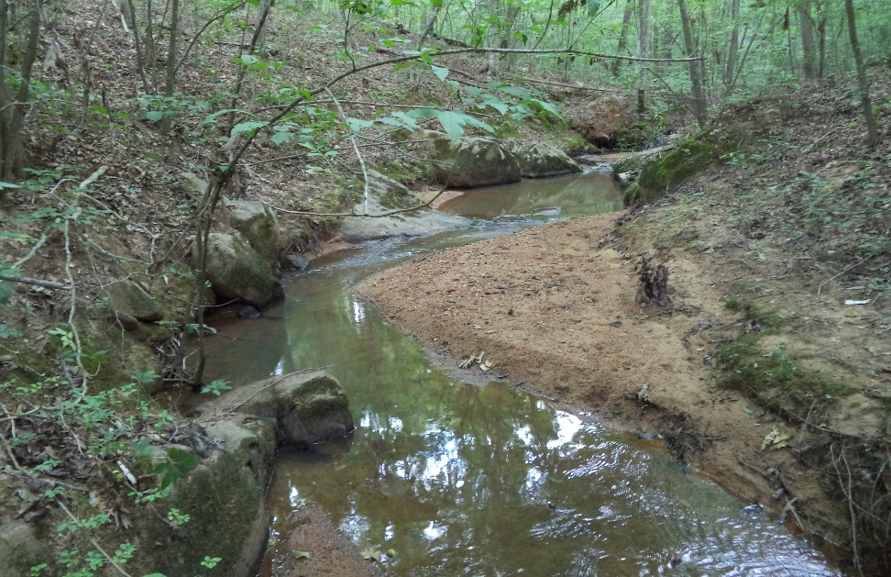
Alternatives Considered for Further Analysis Further Analysis Consisted of:
Field Verified Jurisdictional Waters
Traffic Operational Analysis
Potential Relocations

Slide 26
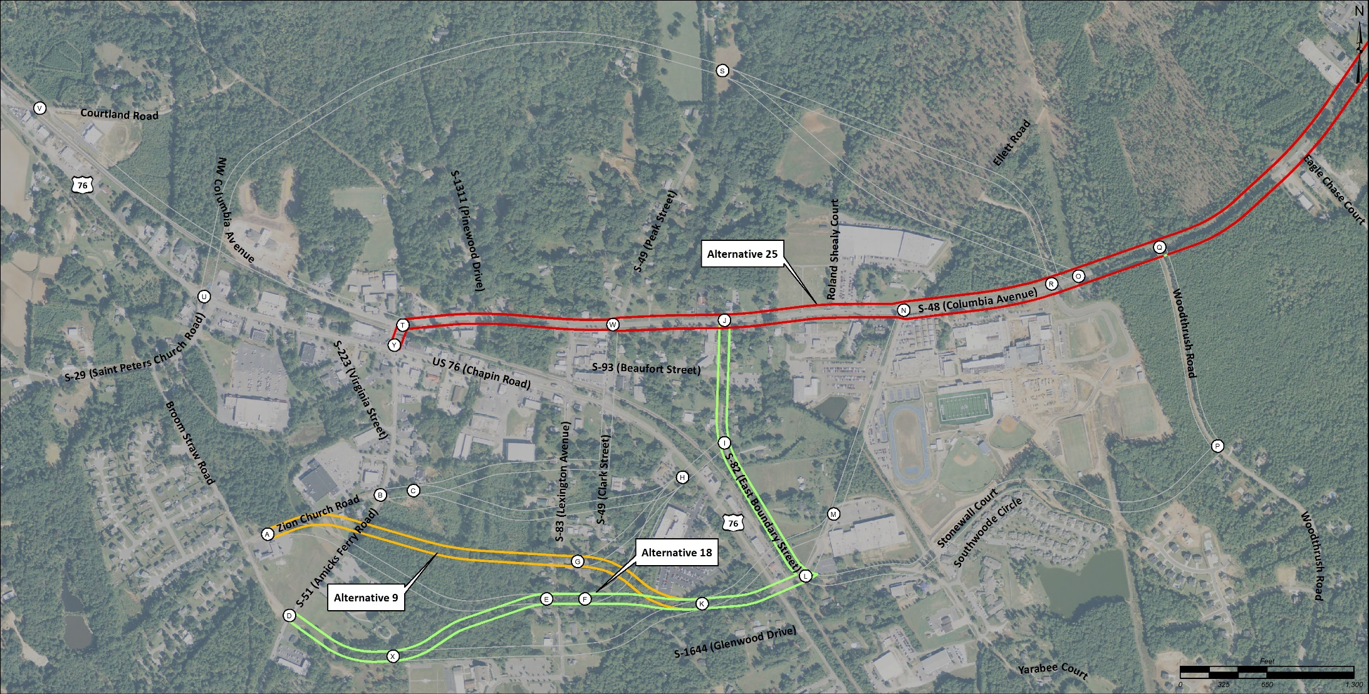
Remaining Alternatives
These three alternatives will be further developed to determine the Preferred Alternative
Alternative 9
Alternative 18
Alternative 25
3 Alternatives

Slide 27
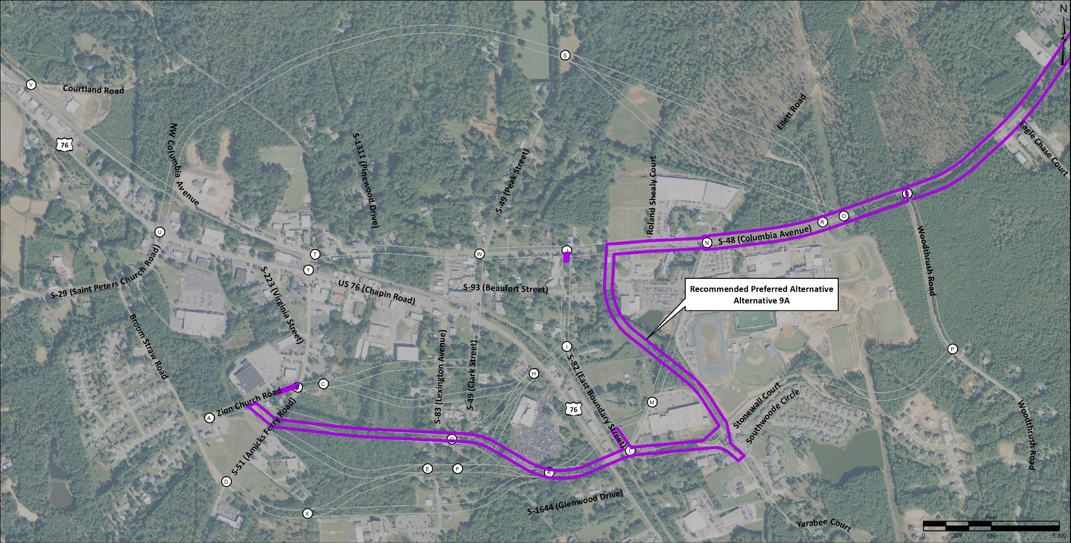
Recommended Preferred Alternative
Alternative 9A
The recommended Preferred Alternative will be presented at a Public Hearing for public comment prior to final selection

