Slide 1
Jennifer Necker, PE
Midlands Program Manager
Robert Dickinson, PE
Acting District 1 Engineering Administrator
John Boylston, PE
Midlands Regional Production Engineer
Chapin Town Hall Meeting
Project Updates
September 29, 2016

Slide 2
Agenda
Safety Improvement Projects
I-26 Widening
Carolina Crossroads
Projects Under Construction
Resurfacing Projects

Slide 3
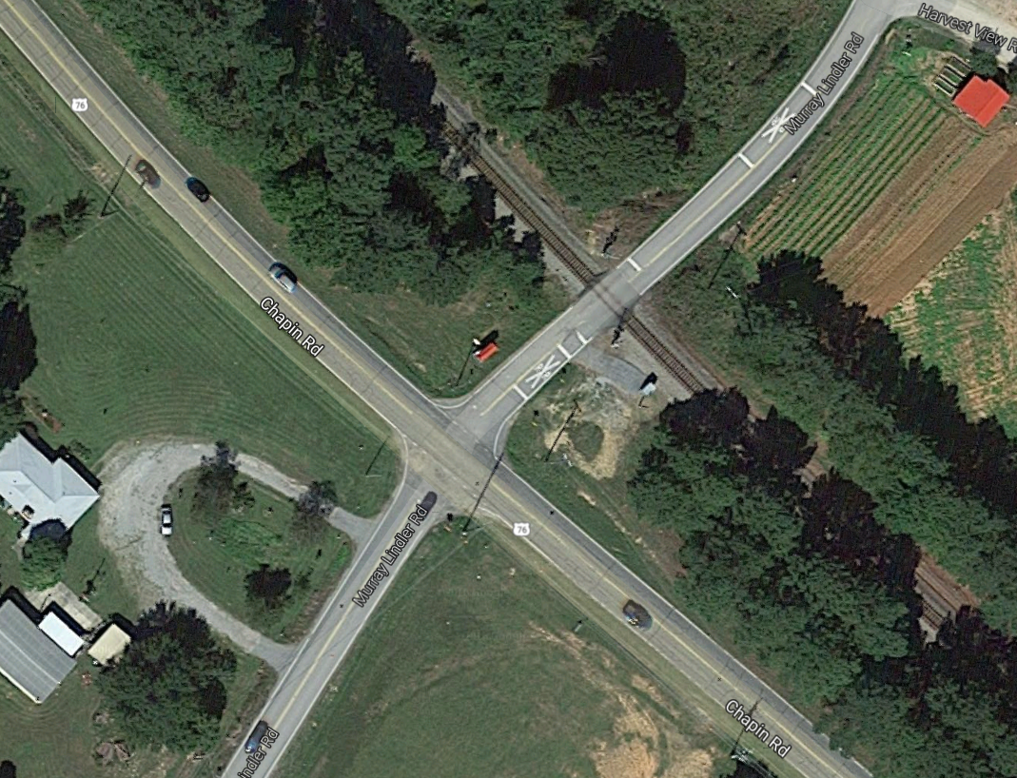
Chapin Rd @ Murray Lindler Rd / East Boundary Street
Traffic Study Underway
Chapin Rd
Murray Lindler Rd
Notes:
Intersection Improvement at US 76 (Chapin Rd.) & S-82 (Murray Lindler Rd/E. Boundary St.), located 0.8 miles SE of the Town of Chapin, Lexington County.
Consultant preparing traffic study
Once traffic study is complete the improvements will be determined and a schedule will be set

Slide 4
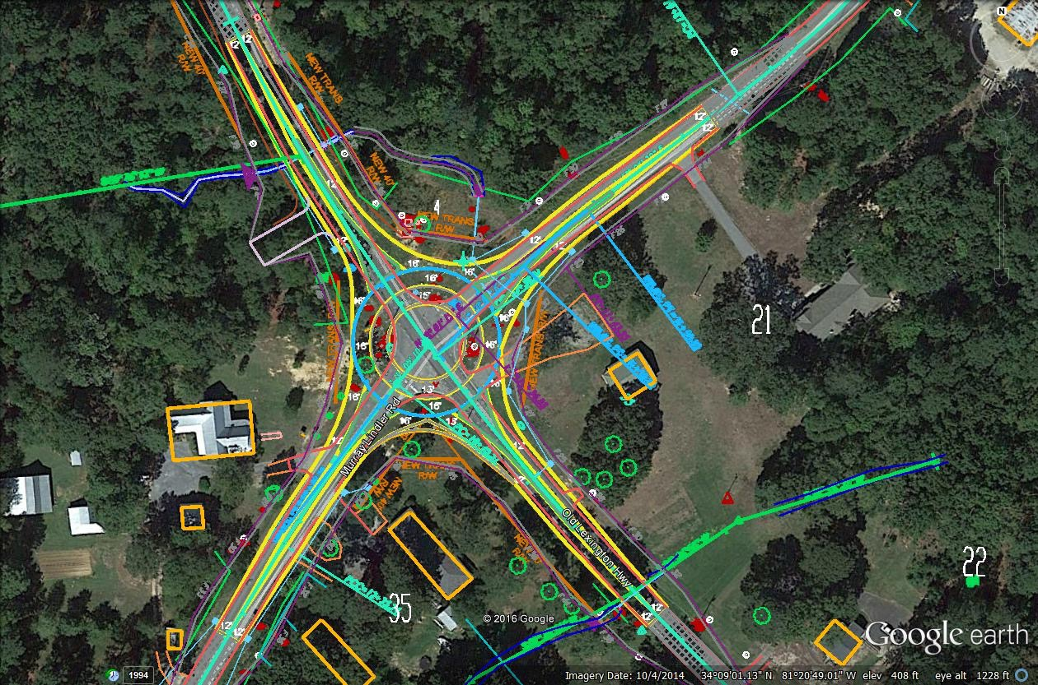

Murray Lindler Road @ Old Lexington Highway
Roundabout
Construction Anticipated Spring 2017
Old Lexington Highway
Notes:
S-82 (Murray Lindler Road) @ S-83 (Old Lexington Highway) & S-940 (Murray Lindler Road)
Tentatively scheduled in the November 2016 Letting

Slide 5
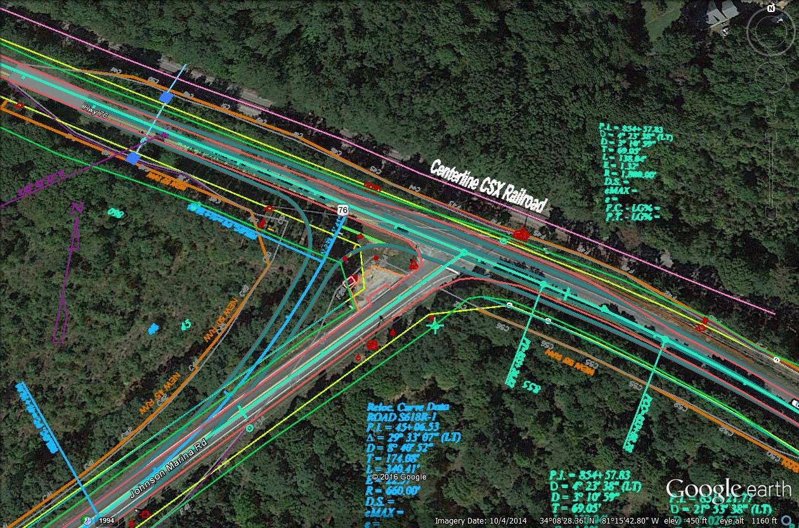
Dutch Fork Rd and Johnson Marina Rd
Improvements to increase safety and sight distance
Construction Anticipated Winter 2016
Dutch Fork Rd
Johnson Marina Rd
Notes:
Intersection Improvement at US 76 (Dutch Fork Rd) and S-618 (Johnson Marina Rd)
Slight realignment to Johnson Marina and left turn lanes on US 76 with sight distance improvements
Project was let this month

Slide 6
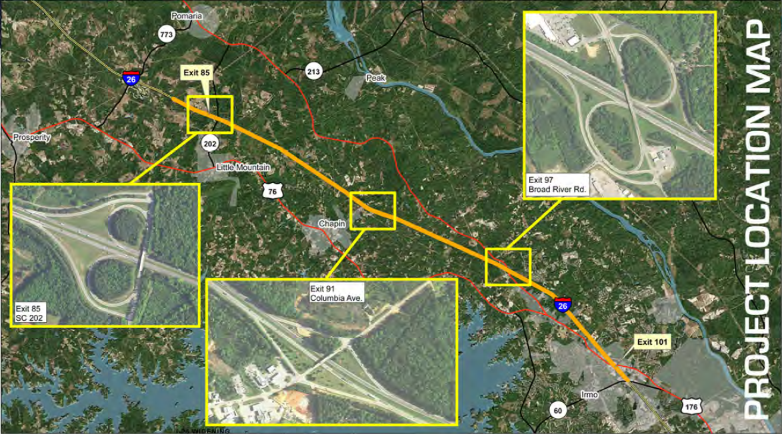
I-26 Widening Project Location Map
Public Information Meetings
  Chapin High School October 11th, 5:00-7:00 PM
  Chapin Middle School October 13th, 5:00-7:00 PM
Notes:
Widen I-26 from MM 101 heading west on I-26 with western termini to be determined
US 176, Exit 101 – Irmo
Widen I-26 from 4 to 6 lanes.
Currently Inspecting and Analyzing Bridges
Once Bridges are inspected and analyzed determination will be made on which ones will be replaced and which ones jacked.
Design-Build
Currently anticipate Bid Opening in Fall 2018

Slide 7
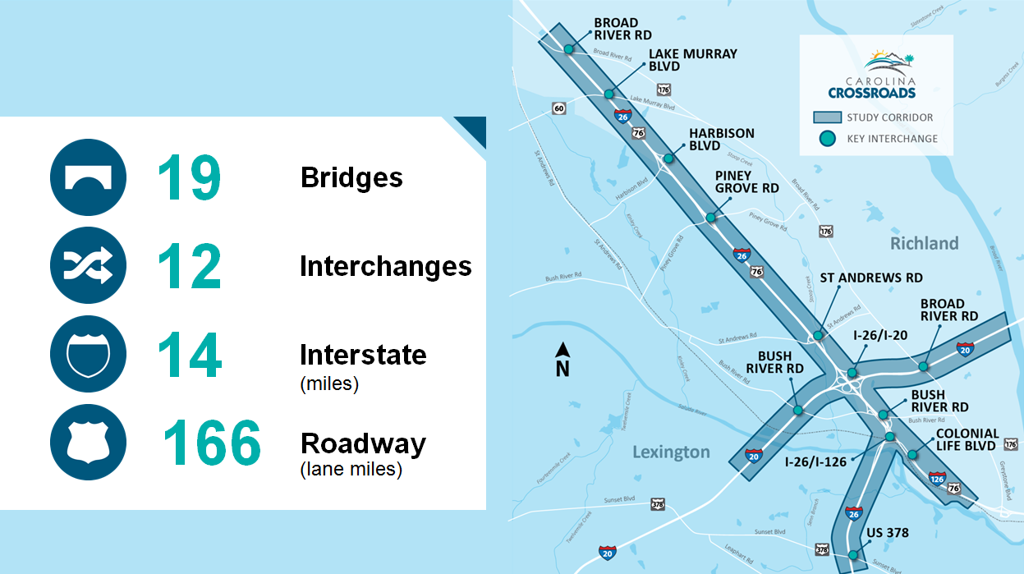
Carolina Crossroads Study Corridor
Alternatives Public Information Meeting
  October 4, 5-7 PM; Presentation at 5:30 PM
  Seven Oaks Elementary School
Check www.SCDOTCarolinaCrossroads.com and FB, Twitter,
Instagram.
Notes:
Halfway through Environmental Impact Statement development. Expect completion in summer 2018.
Project goals are to reduce congestion, increase mobility, and improve safety
Preliminary alternatives will be available for review
The I-20/26/126 Corridor is generally defined as I-20 from the Saluda River to the Broad River, I-26 from US 378 to Broad River Road, and I-126 from Colonial Life Boulevard to I-26. While this corridor is where traffic improvements appear to be most needed, alternative solutions could exist beyond this corridor that would improve traffic conditions within the corridor.
Construction contractor procurement scheduled for 2019

Slide 8
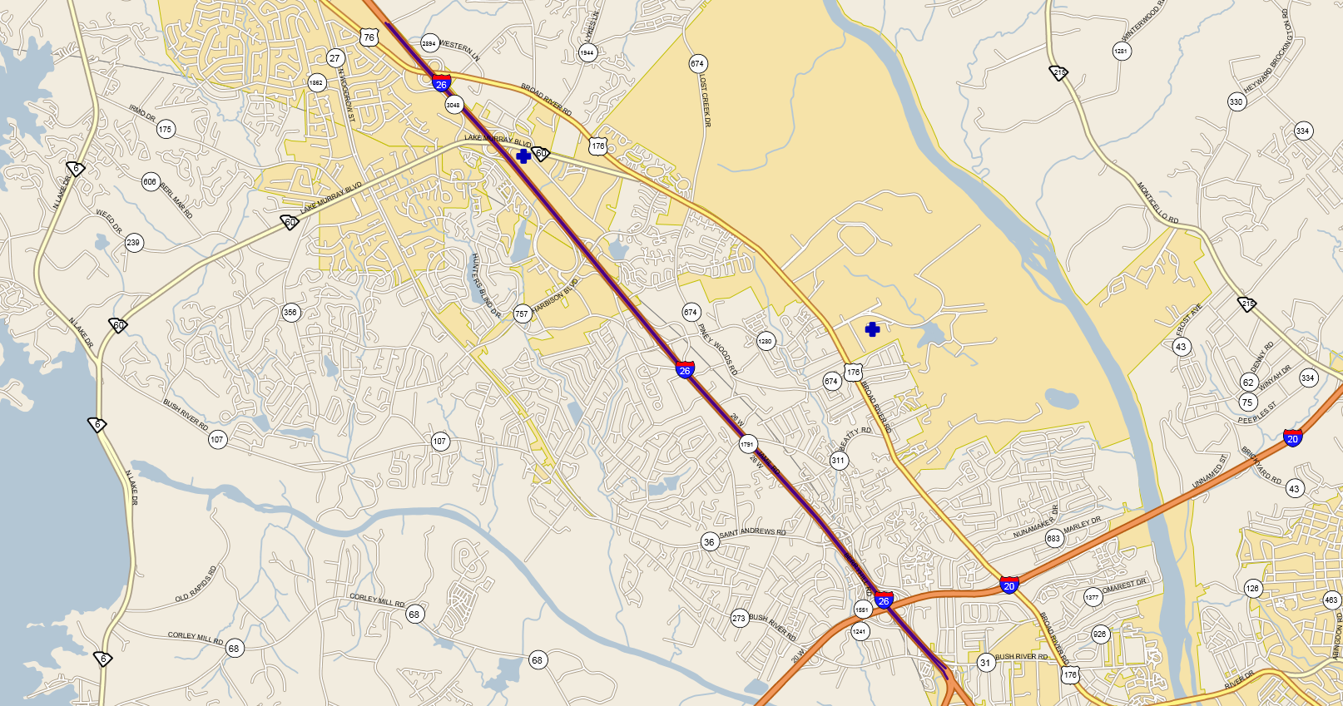
I-26 Pavement Preservation
Start Spring of 2017
Complete by November 30, 2018
Project Engineer Jim Cravens 803 822-0333.
Notes:
Widen I-26 from MM 101 heading west on I-26 with western termini to be determined
US 176, Exit 101 – Irmo
Widen I-26 from 4 to 6 lanes.
Currently Inspecting and Analyzing Bridges
Once Bridges are inspected and analyzed determination will be made on which ones will be replaced and which ones jacked.
Design-Build
Currently anticipate Bid Opening in Fall 2018

Slide 9
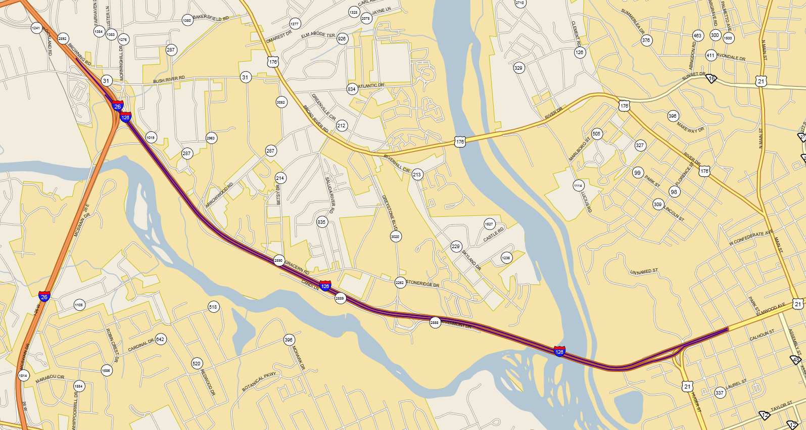
I-126 Pavement Preservation
Start Spring of 2017
Complete by November 30, 2018
Project Engineer Jim Cravens 803 822-0333.
Notes:
Widen I-26 from MM 101 heading west on I-26 with western termini to be determined
US 176, Exit 101 – Irmo
Widen I-26 from 4 to 6 lanes.
Currently Inspecting and Analyzing Bridges
Once Bridges are inspected and analyzed determination will be made on which ones will be replaced and which ones jacked.
Design-Build

Slide 10
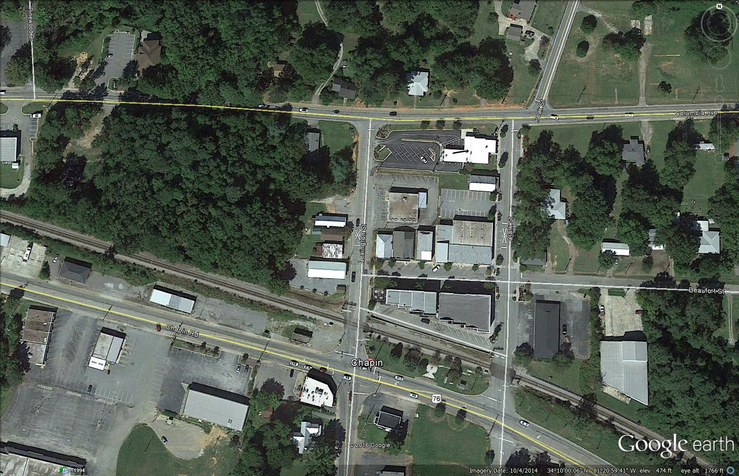
Sidewalk Installation on Lexington Avenue
Lexington Avenue
Notes:
Town of Chapin Enhancement Project. Along Lexington Avenue (S-83).
Located From Columbia Avenue (S-48) to Just North of Chapin Road (US 76)

Slide 11
Projects Under Construction
Trillie Lane and Silver Point Road – RCE Chris Kelly 786-0706.
Peak Street – RCE Robert Power 796-9540.
Amicks Ferry Road – RCE Joey McIntyre 359-4672.
Bush River Road – RCE Joey McIntyre 359-4672.

Slide 12
Resurfacing Projects

Slide 13
QUESTIONS?
Contact Information:
Jennifer Necker, Midlands Program Manager
neckerjl@scdot.org
803-737-7829
Robert Dickinson, Acting District 1 Engineering Administrator
dickinsorc@scdot.org
803-737-6660
John Boylston, Midlands Regional Production Engineer
boylstonjd@scdot.org
803-737-1527

